Slide 1


CSS

Slide 2

CSS?
Stands for Cascading Stylesheet
How HTML elements are displayed
Formatted to different media

Slide 3
CSS - Files
CSS can be imported (in the head) from a .css file
Or it can be coded in the <style> tag
<link rel="stylesheet" type="text/css" href="main.css">
<style> html { margin: 0; color: rgb(0,0,0); } </style>

Slide 4
CSS - Files
Also it can be added to each tag (in the body) using “style” attribute
However, it is not recommended because:
Higher priority
Organization / visualization of styles
More difficult to change
Unnecessarily mix HTML with CSS
<p style="font-size: 10em; margin-left: 30px;">Some text.</p>

Slide 5
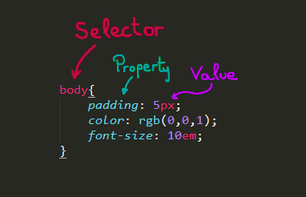
CSS - Syntax
Selectors: HTML elements, classes or IDs
Property: what is modified (from default)
Value

Slide 6
CSS - Selectors
HTML Elements: h1, a, html, body
ID
Unique
#container, #img-logo
Class
For groups
A tag can have one class or more
.highlight, .footer-img

Slide 7
CSS - Selectors
Priorities
Inside the CSS
ID
Class
Element
Loading styles
Inline styles
Internal stylesheets
External stylesheets
Browser styles
!important

Slide 8
CSS - Hierarchy
LEVEL 01
- Inline styles (<p style="color:#fff;">)
LEVEL 02
- ID (#nombreId)
LEVEL 03
- Classes (.className)
- Attributes y Pseudo - Classes (:first-child, :last-child, :hover ...)
LEVEL 04
- Elements (a, p, ul ...)
- Pseudo - Elements (::after, ::before, ::first-letter ...)

Slide 9
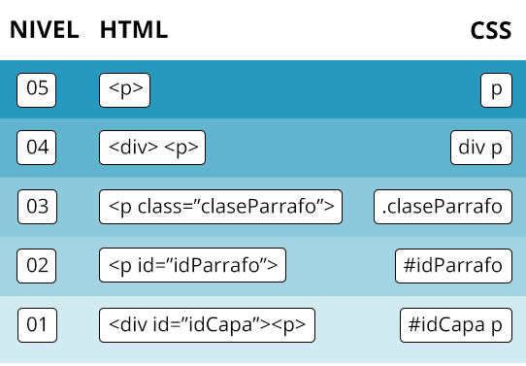

Slide 10
CSS - Selectors
/* NAVIGATING */ article p {} /* All <p> inside <article> */ nav > ul {} /* All <ul> that are direct children of <nav> */ span.im-text {} /* All <span> with class "im-text" */ .nav-text + span {} /* All <span> immediately after something with class "nav-text" */ ol:first-child {} /* Every first child <ol> in the document */ /* GROUPING SELECTORS */ li#special, p.head-text {} /* All <li> with ID "special" and all <p> with class "head-text" */

Slide 11
CSS - Pseudo-classes
To define a special state of an element and style it.
Order is important!
a:link {} /* Unvisited link */ a:visited {} /* Visited link */ a:hover {} /* Mouse over link */ a:active {} /* Selected link */

Slide 12
CSS - Pseudo-elements
To style specified parts of an element.
Note the :: notation.
p::first-line {
color: #ff0000;
font-variant: small-caps;
}

Slide 13
CSS - Common properties
color: change text color
font-size: change text size
background-color: change color in the background of the tag
background-image: adds an image as background of the element
background: edits background properties in one
height/width: changes element’s height/width respectively
border: edit border of the element
border-radius: edit border corners roundness

Slide 14
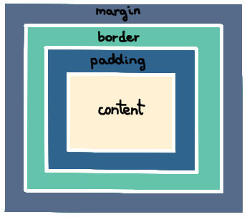
CSS - Margin & padding

Slide 15
CSS - Position
Describes the type of positioning method of the element
static: render in order
absolute: relative to its first ancestor not static
relative: relative to its static position (affected by left, top ...)
fixed: relative to browser window
sticky: relative + fixed
needs a container
needs at least one: top, bottom, left, right

Slide 16
CSS - Floats
To float elements
Does not work with absolute and fixed positions
Related properties
clear: to prevent elements to float around
overflow: to fix the element if it overflows outside the container
Check clearfix hack

Slide 17
CSS - Display
To change display behavior of a tag
inline
block
inline-block: like inline but with block advantages (resizing, margin,...)
flex
grid

Slide 18
CSS - Flexible Box
To organize containers in an easy way
The container parent needs to be “display: flex”
Children position is set in the parent
#flex-parent { display: flex; justify-content: center; flex-direction: column-reverse; }

Slide 19
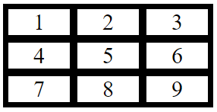
CSS - Grid Layout
To make flexible tables easily with divs
.grid-container { display: grid; grid-template-columns: auto auto auto; padding: 2px; background-color: rgb(0,0,0); } .grid-container div{ background-color: rgb(255,255,255); margin: 5px; font-size: 30px; text-align: center; }
<div class="grid-container"> <div>1</div> <div>2</div> <div>3</div> <div>4</div> <div>5</div> <div>6</div> <div>7</div> <div>8</div> <div>9</div> </div>

Slide 20
CSS - Animations
@keyframe: how the element will change in time
Animation properties:
animation-name
animation-duration
animation-delay
animation-iteration-count
animation-direction
animation-timing-function
animation-play-state
animation: name time timing-function delay iteration-count direction
@keyframes myanimation { from { background-color: rgb(0, 1, 1); }
to { background-color: rgb(1, 1, 0); } }
div { animation-name: myanimation; animation-duration: 2s;
width: 150px;
height: 150px; }

Slide 21
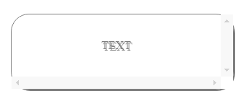
CSS - Other
@font-face { font-family: mywebfont; src: url("webfont.woff"); }
body{ font-family: mywebfont; }
Adding fonts
Other cool properties
div { overflow: scroll; border-radius: 25px; text-shadow: 2px 2px; box-shadow: 2px 2px; font-smooth: antialiased; opacity: 0.5;
box-sizing: border-box;
}

Slide 22

CSS - Responsive Web Design

Slide 23
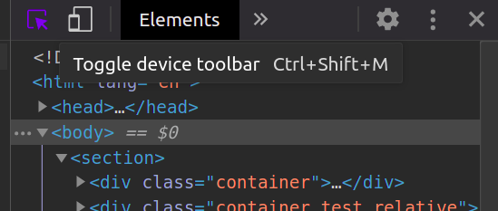
CSS - Responsiveness Tools
How to be aware of my site responsiveness?

Slide 24
CSS - Responsive Length Units
Some CSS units to control responsiveness:
em: Size relative to the font-size of the element (2em = 2*fs(px))
rem: Size relative to the font-size of the root (<html>) element (2rem = 2*fs(px))
vw: Size relative to 1% of the width of the viewport.
vh: Size relative to 1% of the height of the viewport.
%: Relative to the parent element.

Slide 25
CSS - @media
To adapt the content to different media type/devices
screen sizes (default all)
other media
Rule that checks
width and height of viewport and device
orientation (landscape/portrait)
resolution
@media screen and (min-width: 800px) { body { background-color: rgb(0, 1, 1); } }

